Slide 1

Mobile App
1 Click and you are in!

Slide 2
Agenda
Adigo
Installing
Setup
Hosts
Participants
Other ways to improve productivity

Slide 3
Mobile App: Purpose
Faster: 10-15 seconds!
Easier: No access numbers or ID codes
Simpler: Keeps track of multiple bridge accounts

Slide 4
Installing
iTunes
Android Google
Search Adigo

Slide 5
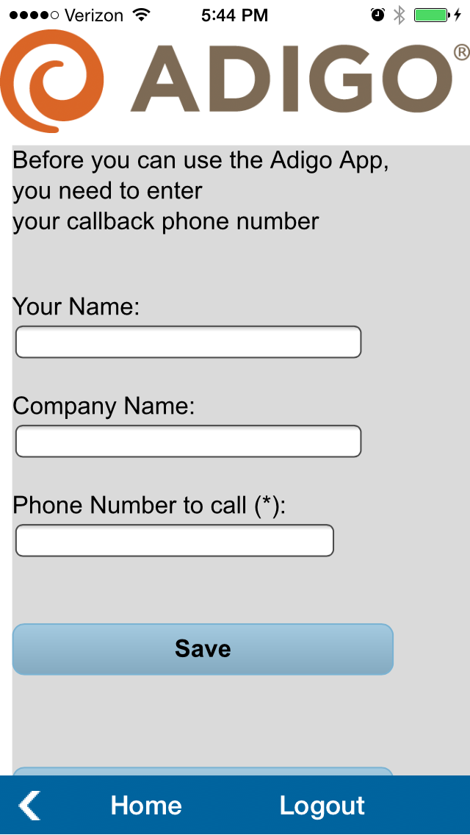
Default screen
Initial screen seen after install
The “Phone number to call” can be customize per conference (i.e.. Cell, home, etc)
International users must include 011

Slide 6
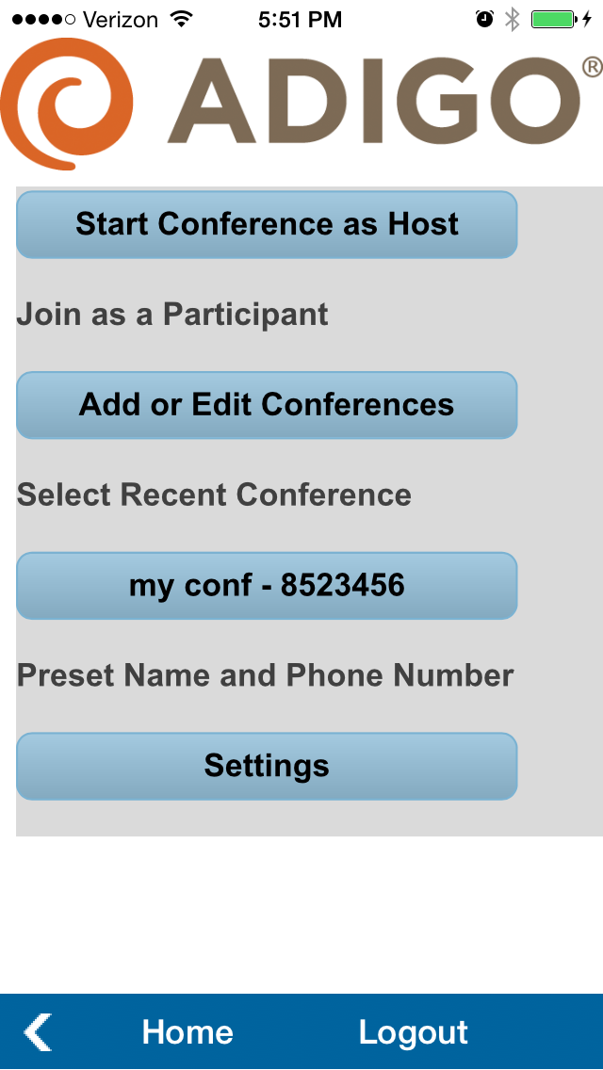
Main screen
First time users will only see the top two options – Start Conference as Host and Add or Edit Conferences
Auto populates the attendees name on the live and archived participant list
Can be used to initiate calls for any phone, including office desk phones

Slide 7
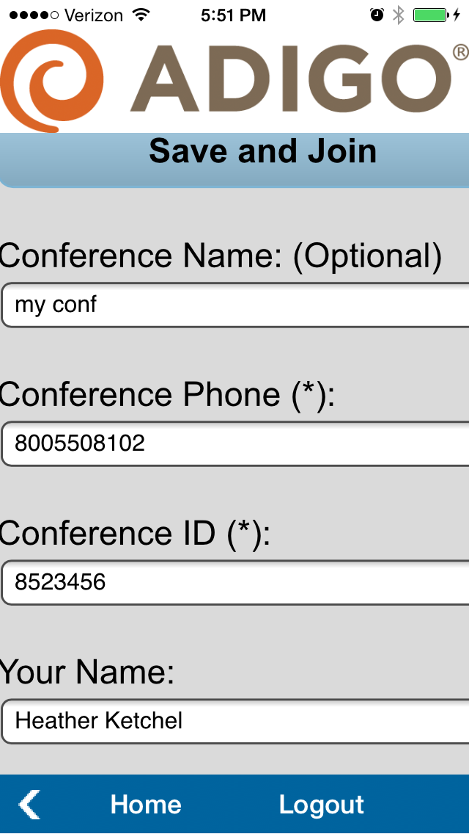
Saving Conferences
* indicates required fields
For the Conference Phone field – for international user, the number must match
Example – UK local number 44 207 099 0867 (do not include +) include country code
Users from UK, still must enter the “44”. Spaces do not matter

Slide 8
Using - Hosts
Select top option to start a conference as a Host
As a Host, to start the call as the Host, press “*”
Phone audio does not prompt you

Slide 9
Using - Participants
This selection will automatically dial you on the number entered for this conference
To change the dial out number, use the add or edit option

Slide 10
Training
Contact Information 24/7:
  support@adigo.com
  888.552.3446 303.390.0700
confidential
Notes:
10

